Slide 1
Competition on real Constrained Real-Parameter Optimization
Lucian TRESTIOREANU
Cristian PORUMB
Xhulio ZEKAJ
M.i.C.S. Semester 2

Slide 2
Previous work:
Performance of CCDA demonstrated against state-of-the-art algorithms on literature benchmarks.
Our main objective:
Apply the co-evolutionary algorithm on the CEC 2017 benchmark problems.

Slide 3
Problem context
Optimization problems contain constraints which need to be satisfied while finding an optimum.
The constraints alter the shape of the search space making it difficult to solve.
Designed for unconstrained optimization, stochastic algorithms require additional mechanisms for constrained problems.
Several designs have been explored with different limitations and efficiency.
Very few approaches have considered co-evolution algorithms like CCDA.

Slide 4
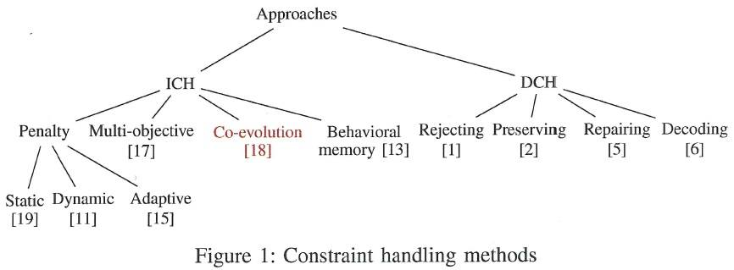
CCDA is different since constraints are not added one by one and evolve at the same time but different context.
The exchange of information is not performed at evaluation but during mating.
Crossover between subpopulations. Preserve diversity – important to avoid local optimal solutions. Mutation inside population.

Slide 5
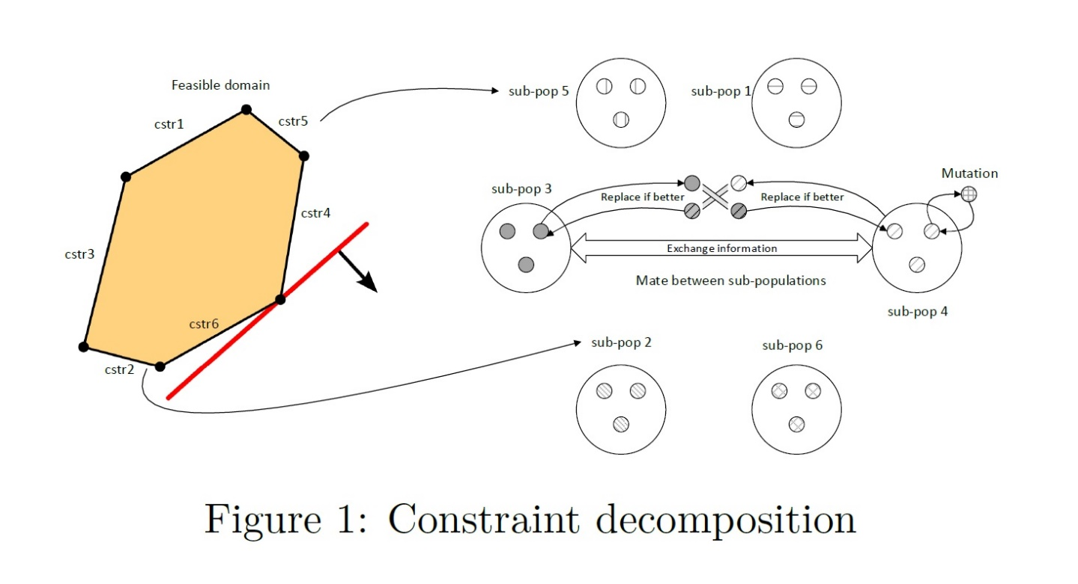
Co-evolutionary constraint decomposition algorithm (CCDA)
Decomposition on constraints.
One sub-population for each constraint.
Each population tries to minimize the violation of its own constraint and then the objective.
Populations try to mutually satisfy each other, and after entering the polyhedron - to minimize the function.

Slide 6
Objective
Implement the 28 benchmark functions.
Run our algorithm on all 28 benchmark functions.
Fine tune the algorithm in order to improve results
Also apply one existing algorithm from literature on the functions.
Compare results between algorithms.

Slide 7
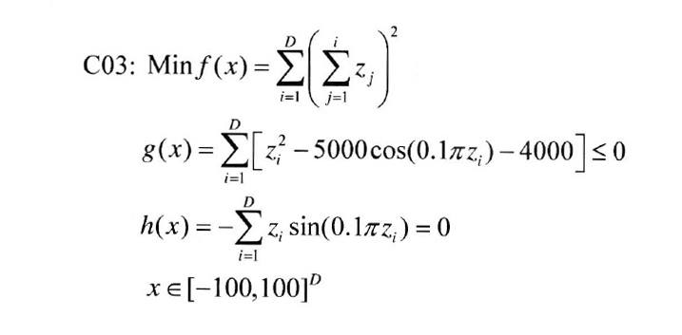
Model (variables, objective functions, contraints)
Each benchmark function has different constraints and shape that need to be satisfied.
The algorithm has to perform well on all benchmarks without special tuning.
Constraints bounding the domain are first satisfied independently using a lexicographic comparison.
Previous experiments have shown that this model is relevant to tackle constraint problems.

Slide 8
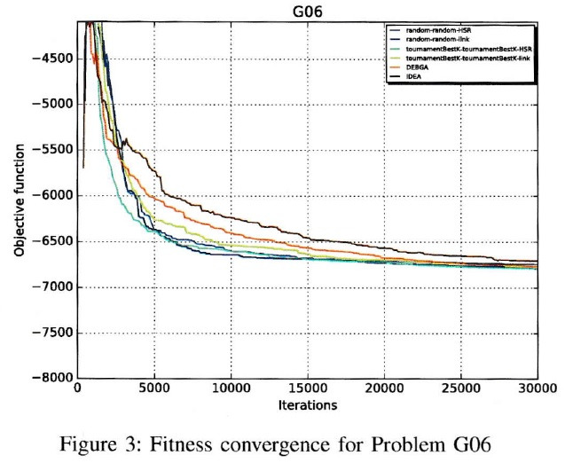
Optimization approach
Done:
Different selection algorithms tested:
target population selection:
lowest satisfaction rule (LSR)
Linkage rule (LR)
individuals selection
Pure random selection R-R
Tournament for best k individuals
of a sub-population (TBK)
A random initial population is used, to ensure diversity at the start point.
To do:
Investigate new ways to select a population, or individuals inside.
Fine tune the algorithm to improve results.

Slide 9
Next steps
Implement benchmark functions.
Decide if focus on testing more functions or implement more performance metrics.
Implement performance metrics.
Comply with requirements of the competition (ex: log also the worst result, document function value f(x) after 2000D, 10.000D, 20.000D).
Run the tests on HPC – Belval.
Quality of the solutions: analysis (ANOVA, Wilcoxon, Kruskal Wallis statistical test in R, Matlab).

